Slide 1
CompPhylo 2019 @MeganRRuffley
Identifying Models of Trait-Mediated Community Assembly using random forests and approximate Bayesian computation
Megan Ruffley, Katie Peterson,
Bob Week, David C. Tank, Luke J. Harmon

Slide 2
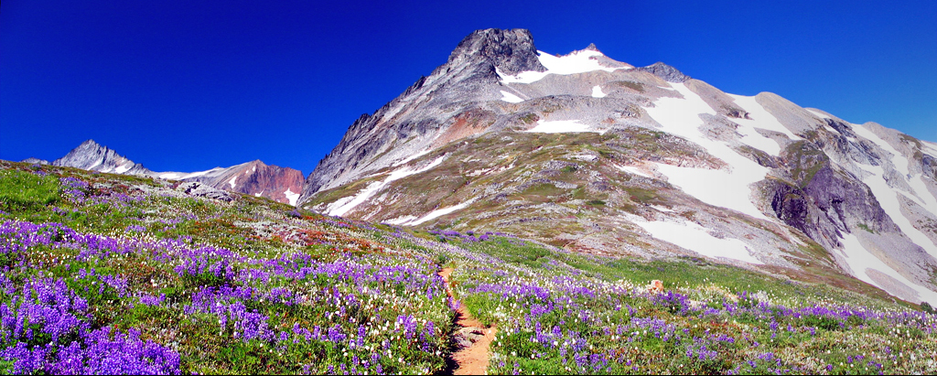
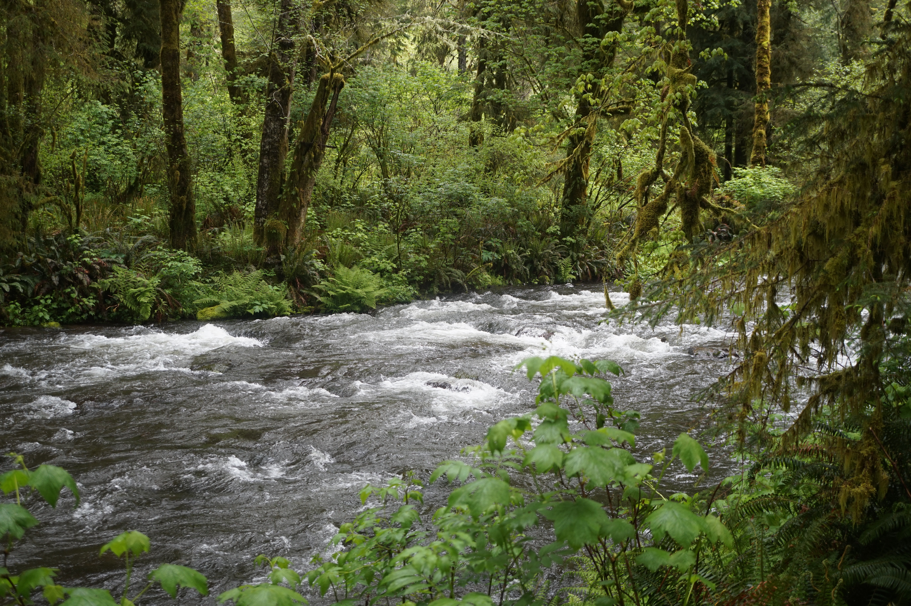
Interested in identifying neutral and non-neutral processes of assembly
Environmental Filtering
Competitive Exclusion

Slide 3
Community Assembly Inference
Phylogenetic Community Structure
Grandcolas 1998, Webb et al. 2000, 2002, Kraft et al. 2007

Slide 4
Community Assembly Inference
Phylogenetic Community Structure
Grandcolas 1998, Webb et al. 2000, 2002, Kraft et al. 2007
Trait Community Structure
Weiher et al. 1999, McGill et al. 2006, Cornwell et al. 2006, Kraft et al. 2007

Slide 5
Community Assembly Inference
Phylogenetic Community Structure
Grandcolas 1998, Webb et al. 2000, 2002, Kraft et al. 2007
Trait Community Structure
Weiher et al. 1999, McGill et al. 2006, Cornwell et al. 2006, Kraft et al. 2007
Weiher and Keddy 1995, Kraft et al. 2007, 2010, Cavender-Bares et al. 2009; Kemble 2009; Mayfield and Levine 2010; Gerhold et al. 2015

Slide 6
CAMI development objectives
Implement a model-based inference procedure

Slide 7
CAMI development objectives
Implement a model-based inference procedure
Compare support for neutral and non-neutral models simultaneously

Slide 8
CAMI development objectives
Implement a model-based inference procedure
Compare support for neutral and non-neutral models simultaneously
Quantify uncertainty associated with the inference

Slide 9
CAMI development objectives
Implement a model-based inference procedure
Compare support for neutral and non-neutral models simultaneously
Quantify uncertainty associated with the inference
Evaluate model adequacy

Slide 10
CAMI development objectives
Implement a model-based inference procedure
Compare support for neutral and non-neutral models simultaneously
Quantify uncertainty associated with the inference
Evaluate model adequacy
Cannot write down a likelihood, so we will need to use an approximate approach based on simulations

Slide 11
CAMI development objectives
Implement a model-based inference procedure
Compare support for neutral and non-neutral models simultaneously
Quantify uncertainty associated with the inference
Evaluate model adequacy
Cannot write down a likelihood, so we will need to use an approximate approach based on simulations
Parameterize the strength of the non-neutral assembly processes

Slide 12
Objective 1: Implement a model-based inference procedure
Ruffley et al. 2019 Ecol. & Evol. Accepted

Slide 13
Objective 1: Implement a model-based inference procedure
Ruffley et al. 2019 Ecol. & Evol. Accepted

Slide 14
Objective 1: Implement a model-based inference procedure
Neutral
Environmental Filtering
Competitive Exclusion
Ruffley et al. 2019 Ecol. & Evol. Accepted

Slide 15
Objective 2: Parameterize the strength of the non-neutral assembly processes
Ruffley et al. 2019 Ecol. & Evol. Accepted

Slide 16
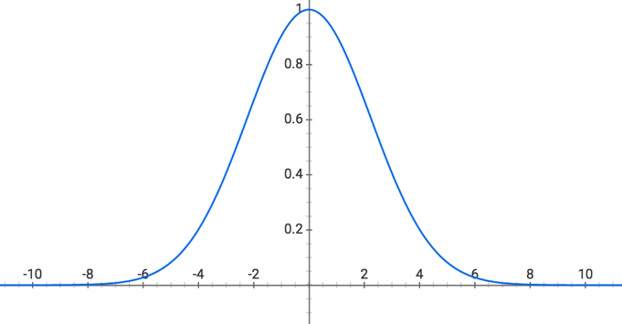

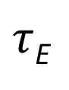
Objective 2: Parameterize the strength of the non-neutral assembly processes
Environmental Filtering
$$P= e^{− \frac{{\left(Zi−Zj\right)}^{2}}{τ}}$$
$τ$_{E}
Ruffley et al. 2019 Ecol. & Evol. Accepted

Slide 17
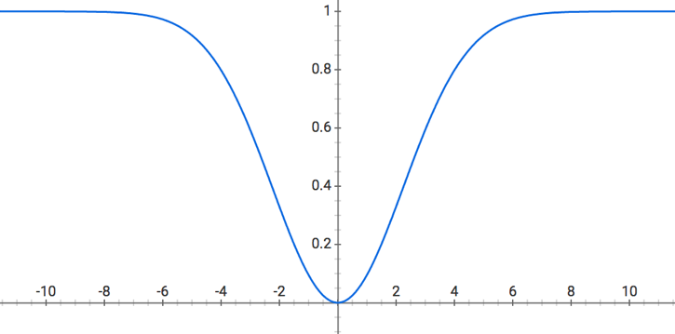
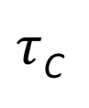
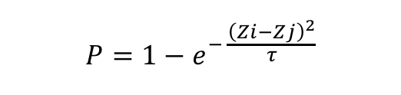
Objective 2: Parameterize the strength of the non-neutral assembly processes
Environmental Filtering
Competitive Exclusion
$$P= e^{− \frac{{\left(Zi−Zj\right)}^{2}}{τ}}$$
$$P=1−e^{− \frac{{\left(Zi−Zj\right)}^{2}}{τ}}$$
$τ$_{C}
$τ$_{E}
Ruffley et al. 2019 Ecol. & Evol. Accepted

Slide 18
Objective 1: Implement a model-based inference procedure
Model-selection using likelihood-free approaches
randomForests (Breiman 2001, Breiman and Cutler 2007)
Approximate Bayesian Computation (ABC; Beaumont, et al. 2002, Csilléry, et al. 2012)

Slide 19
Results
Power Analysis
Parameter Estimation
Empirical studies

Slide 20
Results
Power Analysis
Dispersion Metrics
Phylogenetic data
Functional trait data
randomForest (RF)
ABC

Slide 21
Results: Power Analysis
Ruffley et al. 2019 Ecol. & Evol. Accepted

Slide 22
Results
Power Analysis
Parameter Estimation
-Estimate τ_{E} and t_{C}
Empirical studies

Slide 23
Results: Parameter Estimation
BM
OU
Ruffley et al. 2019 Ecol. & Evol. Accepted

Slide 24
Results
Power Analysis
Parameter Estimation
Empirical studies
Lava-flow Islands
San Juan Islands

Slide 25
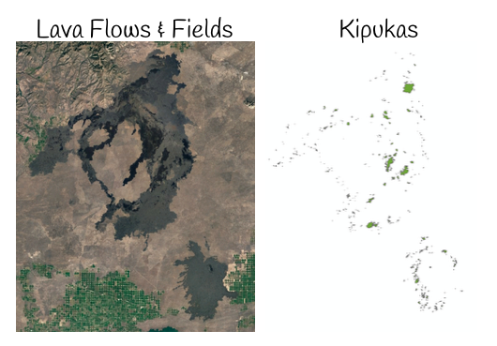

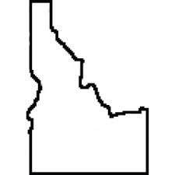
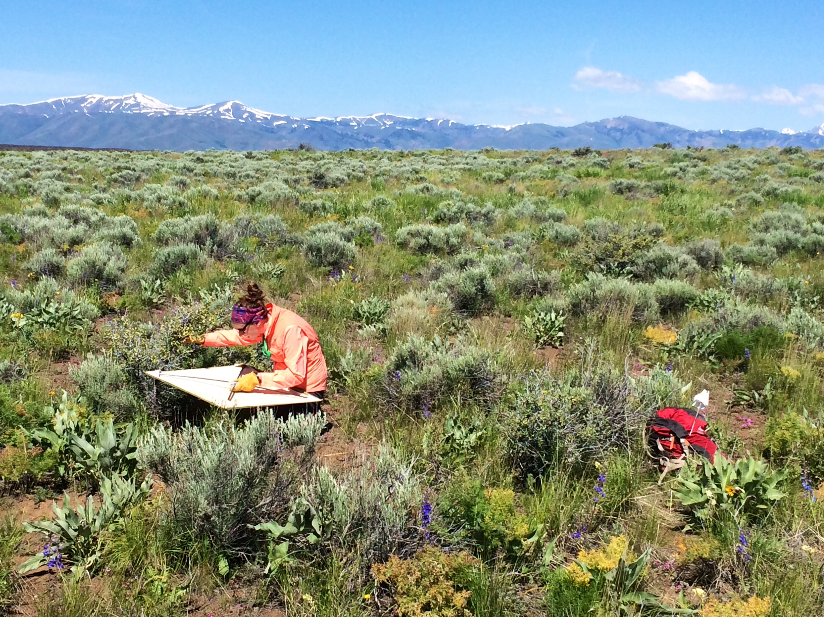
Results: Lava-flow Islands in Craters of the Moon National Monument and Preserve
Katie Peterson
Dr. Christine Parent lab
University of Idaho

Slide 26
Results: Lava-flow Islands in Craters of the Moon National Monument and Preserve
local
community
phylogeny
regional
community
phylogeny

Slide 27

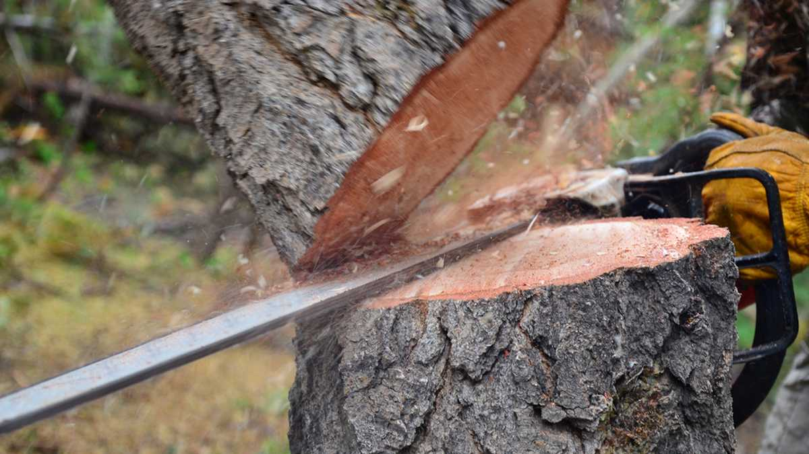
Results: Lava-flow Islands in Craters of the Moon National Monument and Preserve
Spermatophyta phylogeny 79,881 tips
Discarded 79,768 tips (99.9% )
8 kipuka communities
113 species in regional community
18-60 species in local community
Smith, S. A., and J. W. Brown. 2018. Constructing a broadly inclusive seed plant phylogeny. American Journal of Botany 105(3): 302-314.

Slide 28
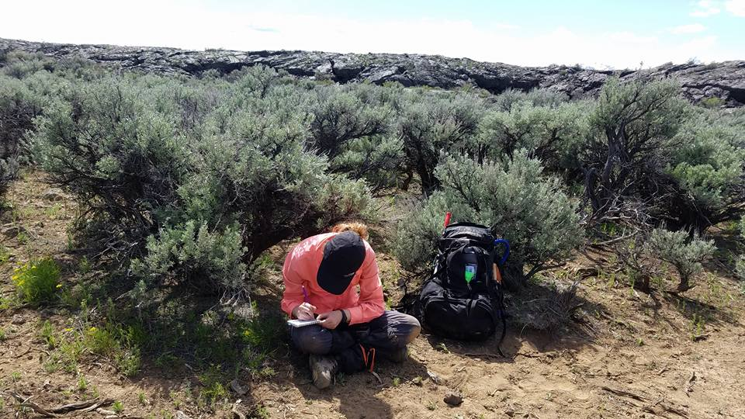

Results: Lava-flow Islands in Craters of the Moon National Monument and Preserve
Maximum vegetative height

Slide 29
Results: Lava-flow Islands in Craters of the Moon National Monument and Preserve

Slide 30
Results: Lava-flow Islands in Craters of the Moon National Monument and Preserve

Slide 31
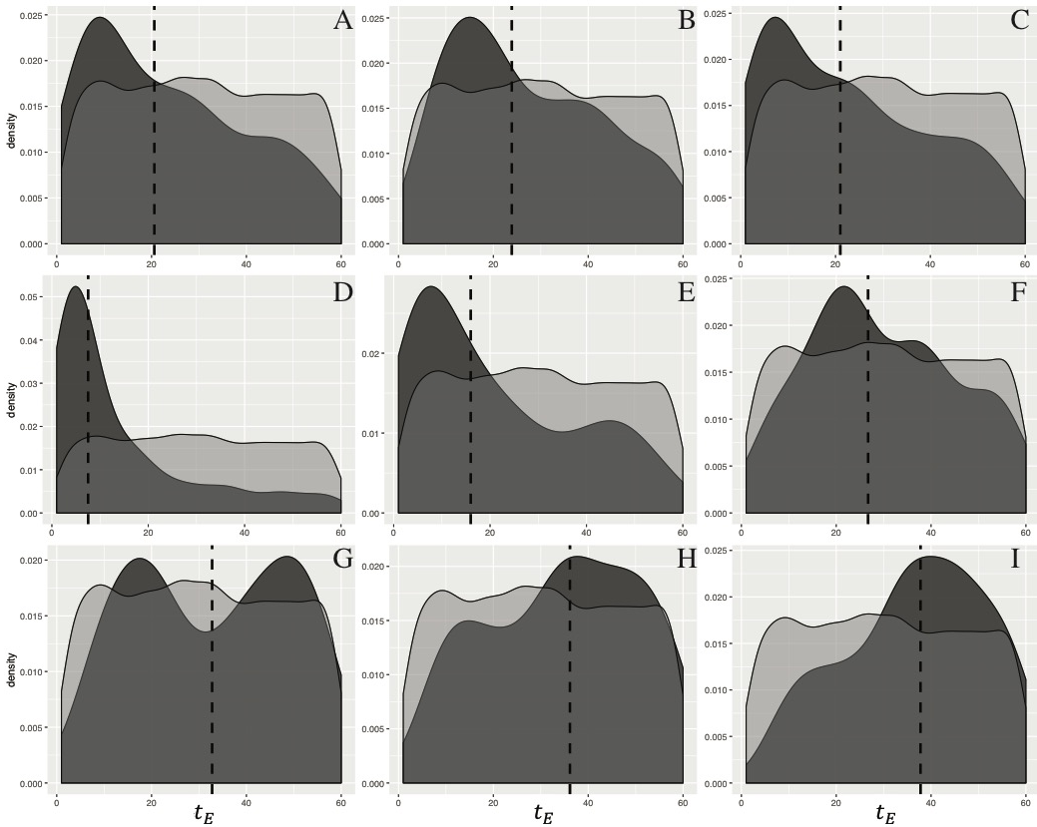
Results: Lava-flow Islands in Craters of the Moon National Monument and Preserve
Ruffley et al. 2019 Ecol. & Evol. Accepted

Slide 32
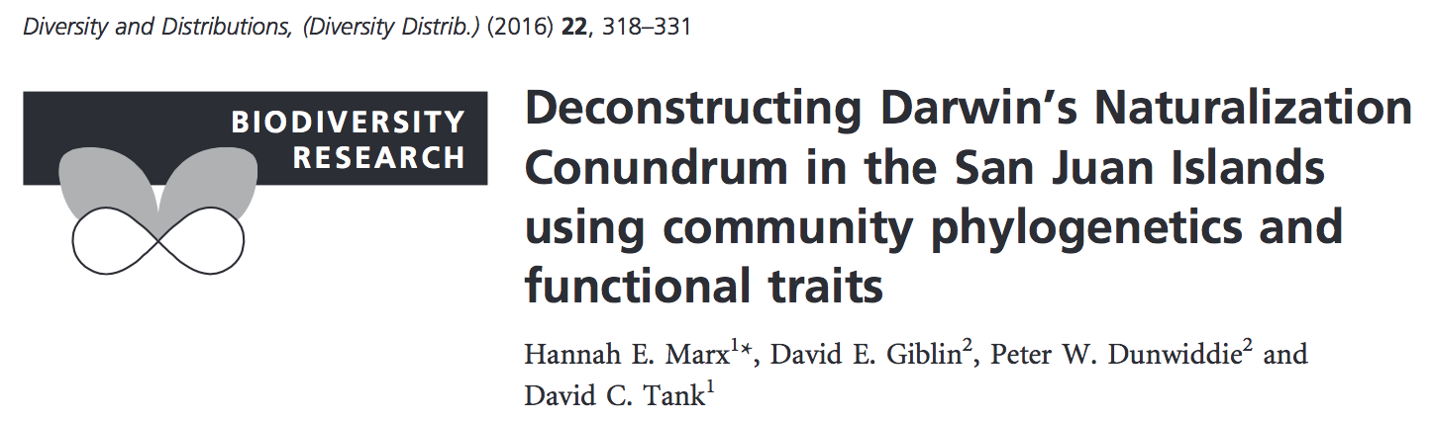
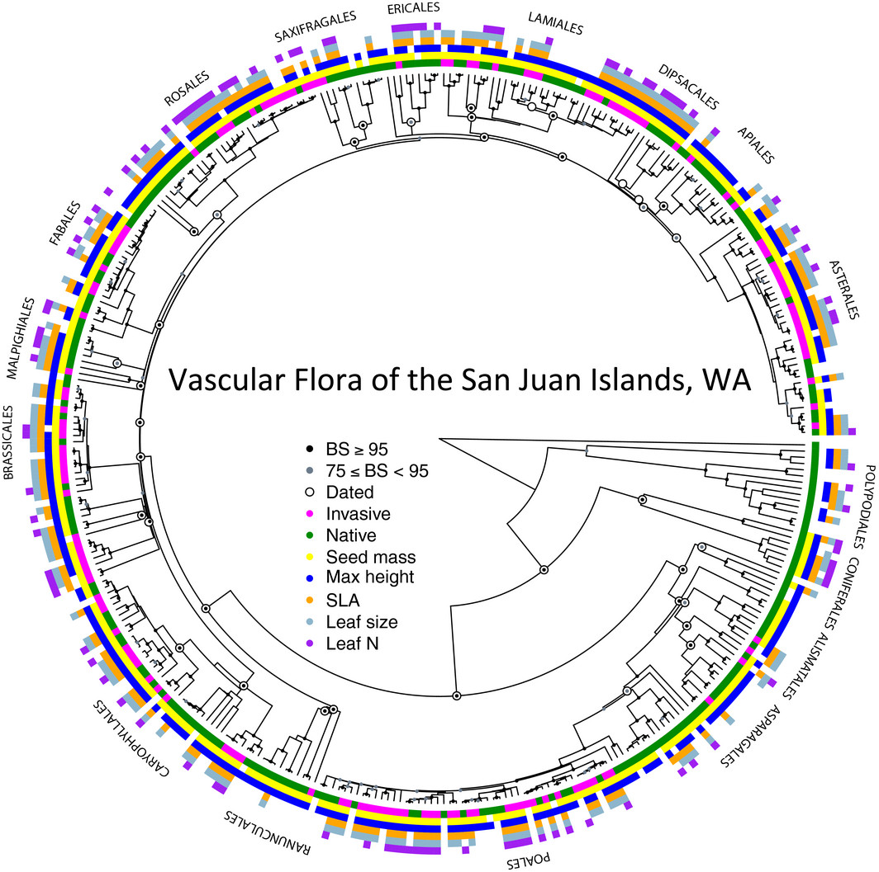
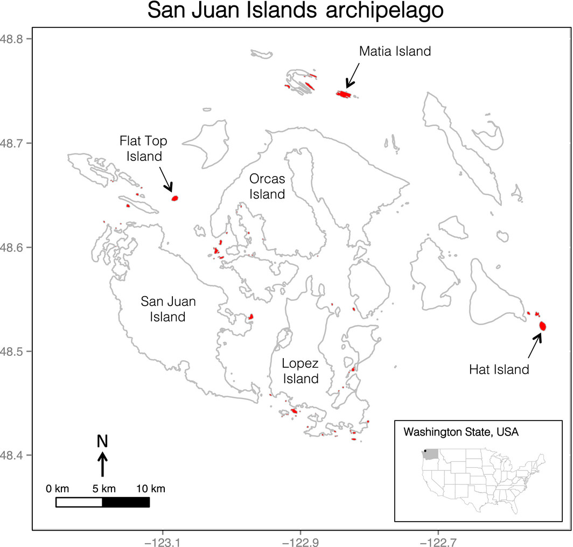
Results: San Juan Islands in the Pacific Northwest

Slide 33
Results: San Juan Islands in the Pacific Northwest

Slide 34
CAMI Conclusions
Simulate phylogenetic and phenotypic community assembly data under neutral and non-neutral models of assembly
Implements a model-based inference procedure
Model-selection
Parameter estimation
Model adequacy/fit
CAMI: Community Assembly
Model Inference
R package and docs available now @
https://github.com/ruffleymr/CAMI

Slide 35
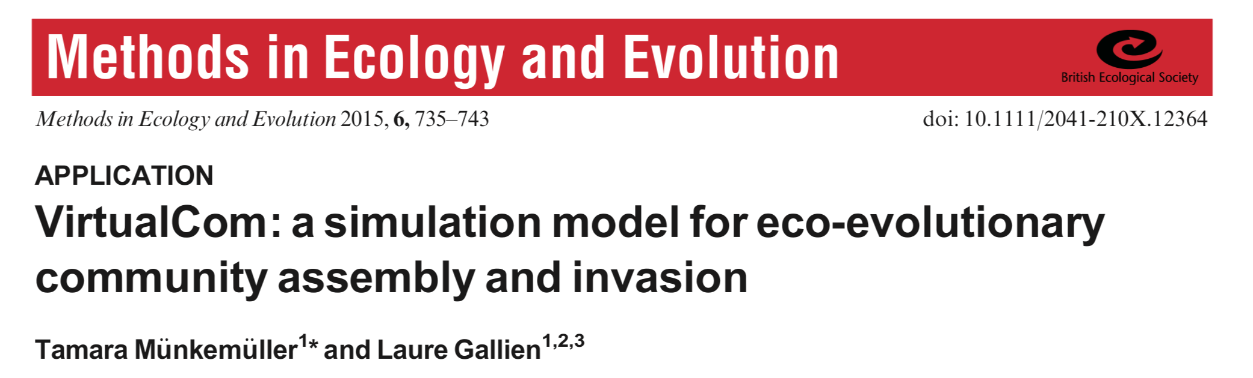
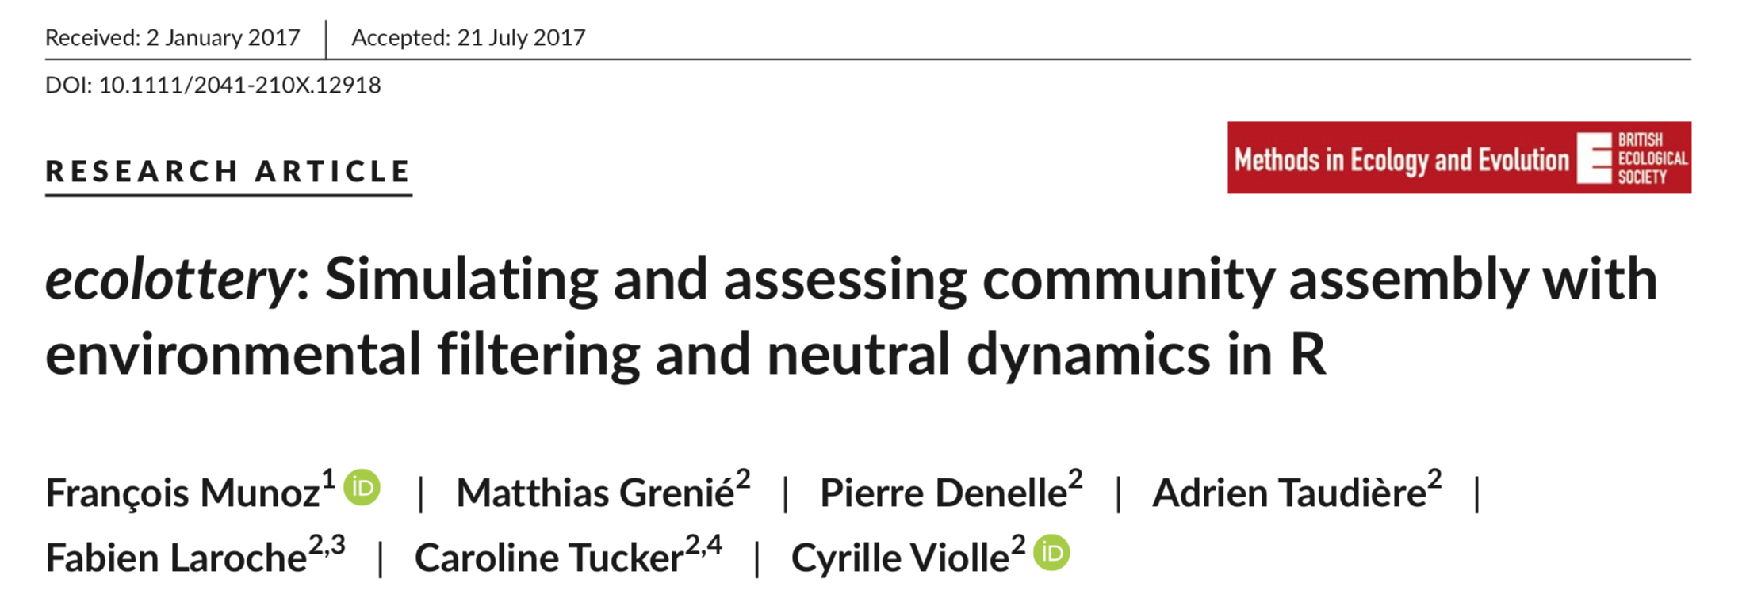
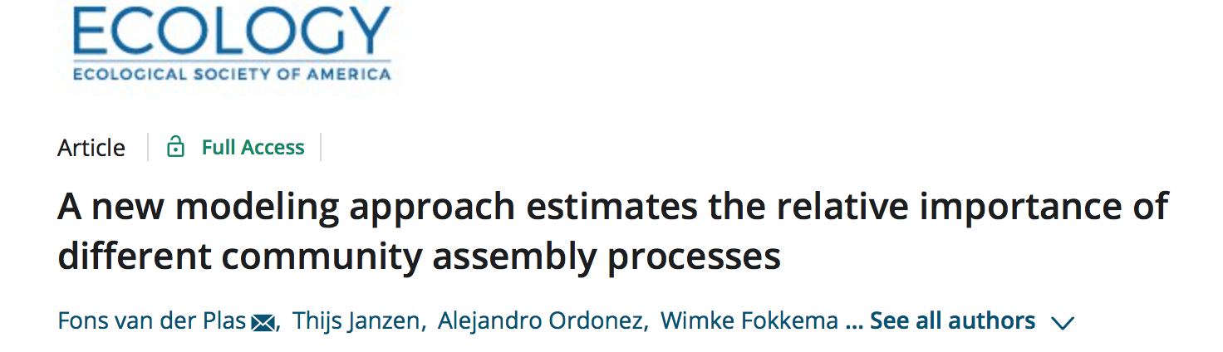
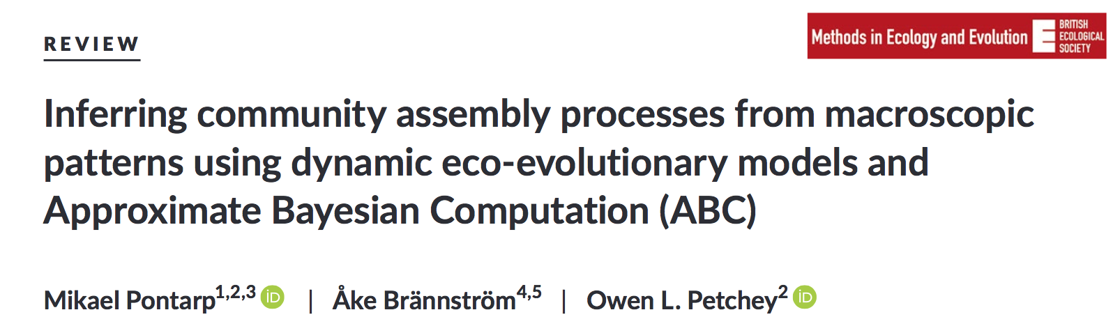
CAMI: Community Assembly
Model Inference
R package and docs available now @
www.github.com/ruffleymr/CAMI

Slide 36

Ruffley M, Peterson K, Week B, Tank DC, Harmon LJ (2019). Identifying models of trait-mediated community assembly using random forests and approximate Bayesian computation. Ecology and Evolution. Accepted.
Thank You!
Hannah Marx
Isaac Overcast
Mike Hickerson
Andy Rominger
James Rosindell
Megan Smith
Sarah Jacobs
Rosana Zenil-Ferguson
Daniel Caetano
Christine Parent
Bryan Carstens
Josef Uyeda
Anahi Espindola
Malia Santos
Sam McCauley
Harpo Faust
Dan Turck
CAMI: https://github.com/ruffleymr/CAMI
MESS: https://github.com/messDiv/MESS
github.com/ruffleymr

